Slide 1
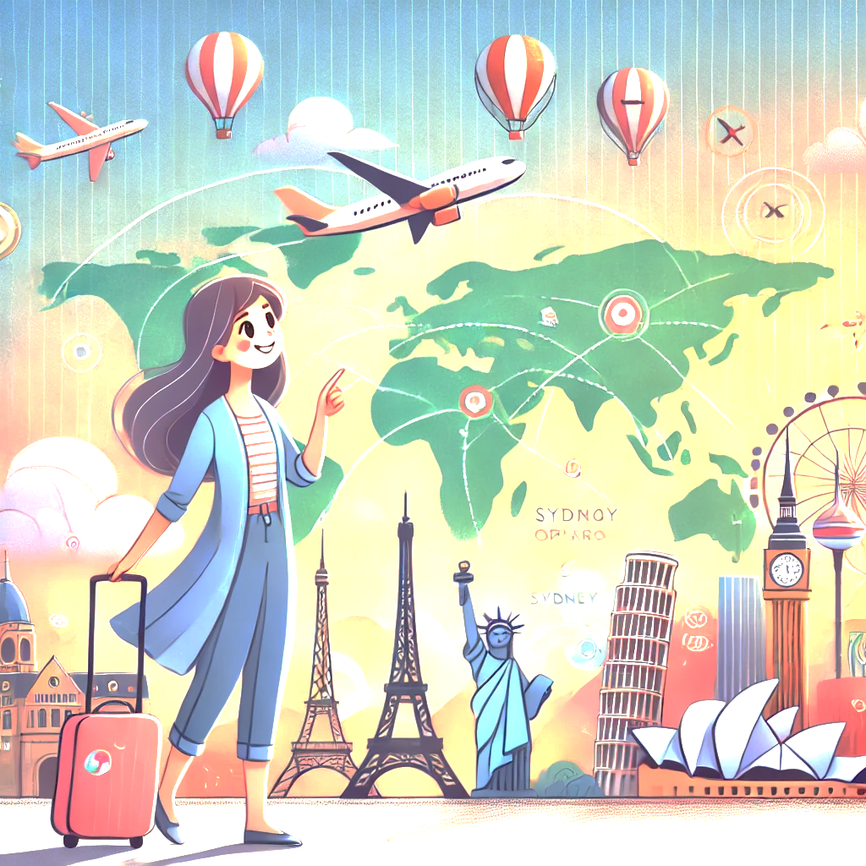
WanderTales: AI-Powered Travel Stories & Recommendations
Experience Your Journey Before It Begins – Smart AI Travel Planning

Slide 2
Introduction
Problem: Travelers often struggle to plan personalized trips and visualize their experiences in advance.
Objective: Our AI-driven app solves this by creating customized travel itineraries, immersive stories, and realistic AI-generated images & videos, helping users explore their journey before it even begins.

Slide 3
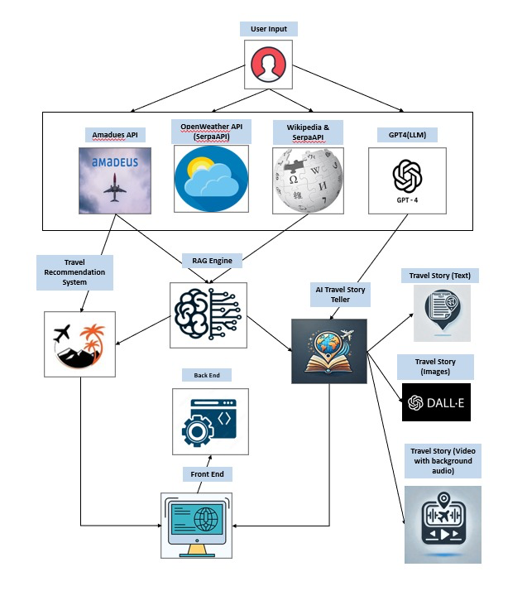
System Architecture

Slide 4
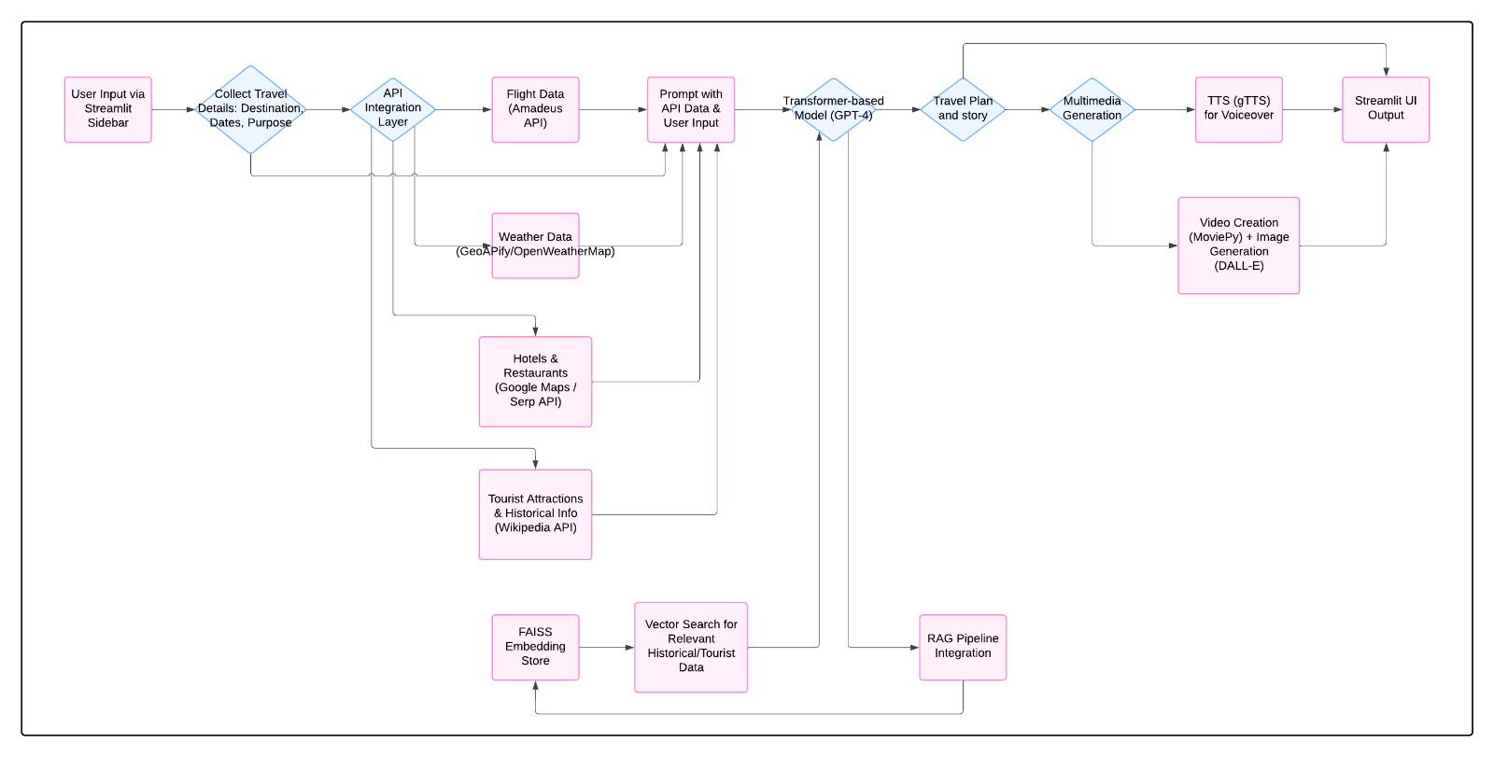
Model Workflow

Slide 5
Application Interface (UI/UX)
Wireframe Overview
Left Sidebar: Users enter origin, destination, travel dates, and purpose for personalization.
Main Display: AI-generated travel plan, story, and realistic images/videos appear dynamically.
Interactive Elements: Smooth transitions, engaging layouts, and clear visual hierarchy enhance usability.
User Flow:
Enter Details → AI Generates Personalized Content → View & Explore Travel Plan with Multimedia

Slide 6
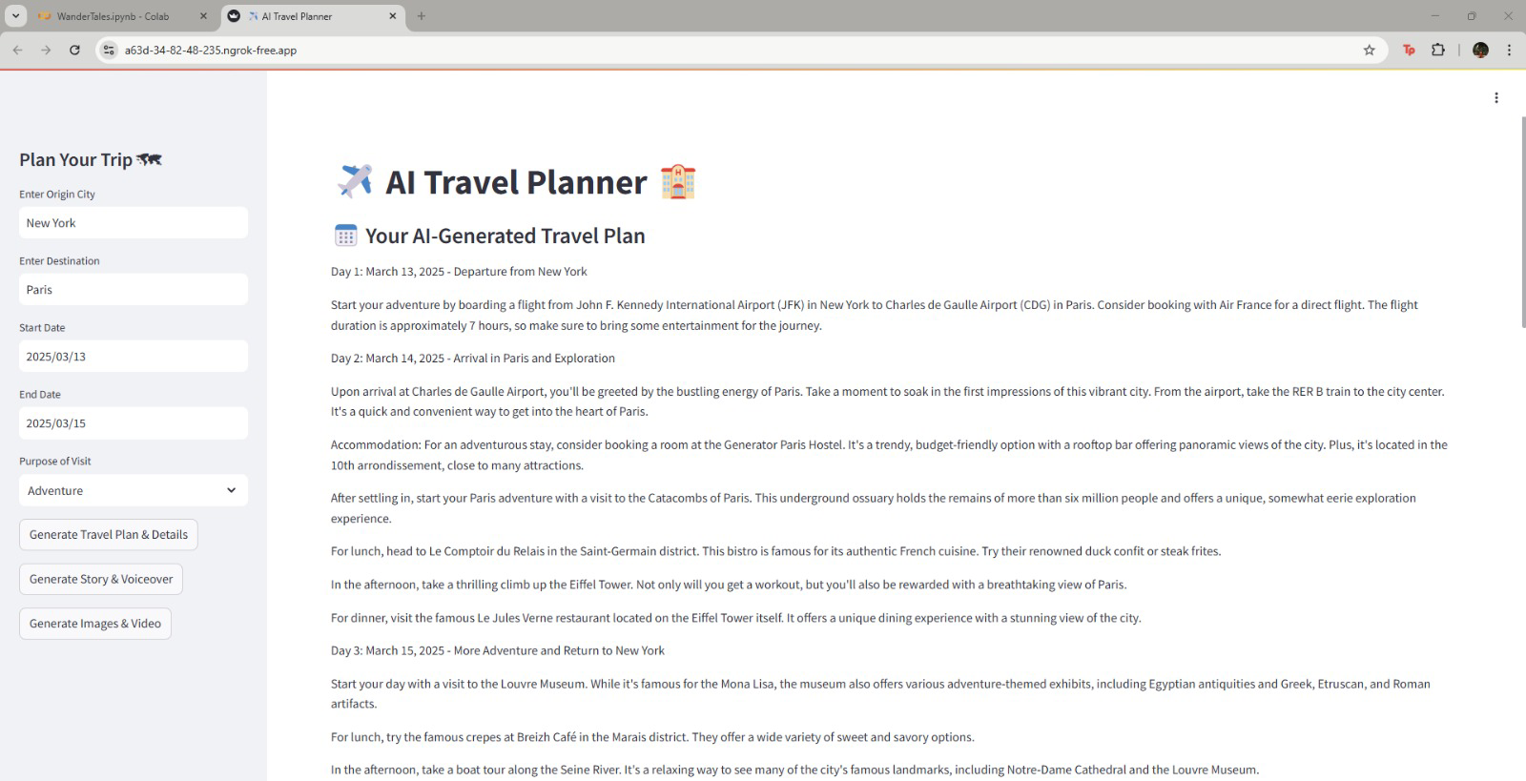

Slide 7
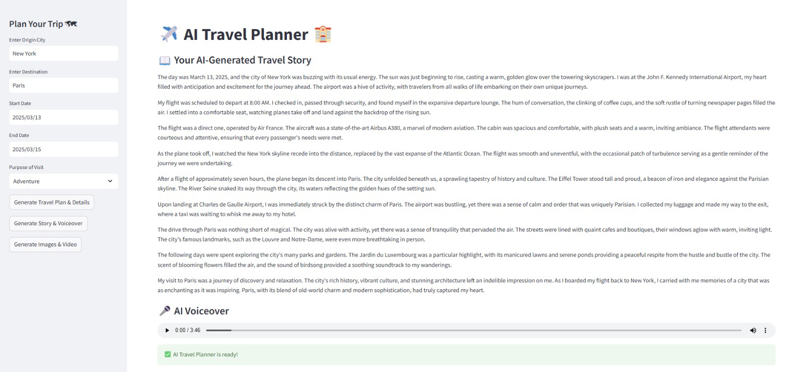

Slide 8
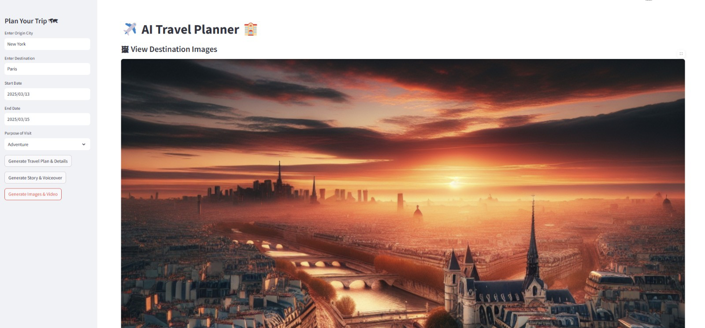

Slide 9
Models and Technologies
GPT-4 – Fine-tuned for personalized, coherent travel plans
DALL·E – Created realistic, prompt-accurate travel images
RAG – Enhanced plans with real-time travel data
gTTS – Converted stories into natural-sounding audio

Slide 10
PERFORMANCE METRICS(To be done)
BLEU Score – Evaluates how closely AI-generated travel stories match human-written ones.
F1-Score – Measures the accuracy of AI travel plans by checking place, flight, and weather details.

Slide 11
NeurIps paper implementation
Core Idea: Leverage a pre‐trained diffusion UNet encoder to extract rich semantic features from any image.
Segmentation: Apply a recursive Normalized Cut on those features to partition the image into coherent regions—no labeled data needed.
Refinement: Use a pixel‐affinity module (PAMR) and median filtering to sharpen boundaries and clean up noise.

Slide 12
DiffCut and Normalised cut algorithm application
Set Up & Cloning: Pulled the DiffCut repo into Colab, installed dependencies, and resolved import paths.
Custom Image Upload: Allowed manual upload of any travel photo (e.g. Eiffel Tower + boy).
Feature Extraction & Masking: Ran the LDM extractor, generated raw segmentation masks, then refined them.
Overlay View: Color‐coded mask on top of the original for clear region separation.
Isolation View: Automatically isolated the main subject and blurred the background for a polished look.

Slide 13
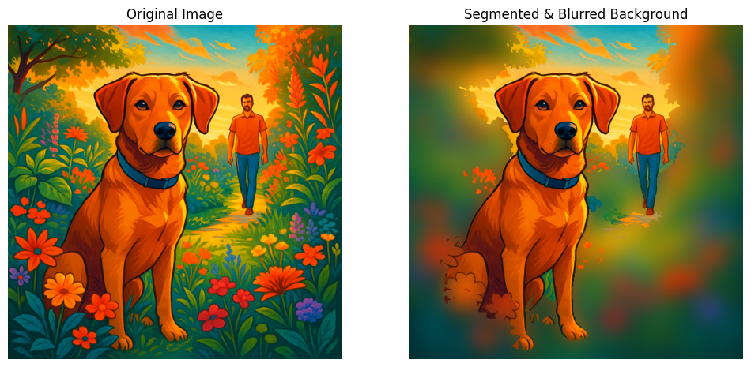
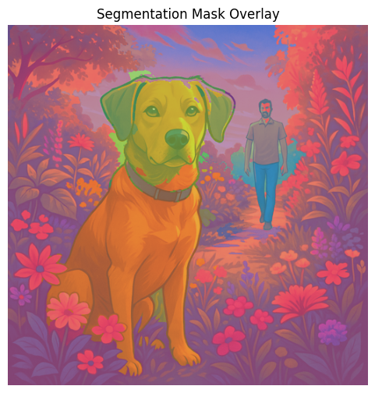
Sample results

Slide 14
Relevance to wandertales
Auto Landmark Highlighting: Zero-shot masks let us spotlight monuments, attractions, or key objects in user photos without manual cropping.
Enhanced Storyboarding: Isolated subjects can be recombined into AI-generated scenes, sketched visuals, or AR overlays—making each itinerary slide more engaging.
Time & Scale: Works “out of the box” on any photo (historic, user-snapped, AI-created), so WanderTales can scale visual storytelling without extra labeling effort.
Next Steps: Integrate mask-based filters, thematic overlays, and interactive annotations to further enrich the travel narratives.

Slide 15
Contributions
Viswanth Tammana: Developed a Travel Recommendation System, Integrated APIs, explored Stable Diffusion for images, experimented with animation, and documented AI/ML architecture. Implemented DiffCut paper.
Dharani Thakkallapally: Optimized AI-driven travel stories, visuals, and videos, enhanced personalization, improved performance with ONNX, and documented progress.
Pavan sundar reddy guthikonda: Developed and deployed the Streamlit frontend, resolved deployment issues, optimized UI performance, and improved app speed with async API calls.
Banu Teja Jampani: Developed a Travel Recommendation System integrating APIs for hotels, restaurants, and seamless itinerary planning based on user preferences

Slide 16
Future Work
Enhancing video generation with dynamic elements
Deployment
Performance metrics

Slide 17
Conclusion
Our AI-powered travel companion transforms trip planning into an immersive adventure, delivering personalized itineraries, stunning visuals, and interactive previews. With real-time insights and AI-driven storytelling, we make every journey exciting before it even begins

Slide 18
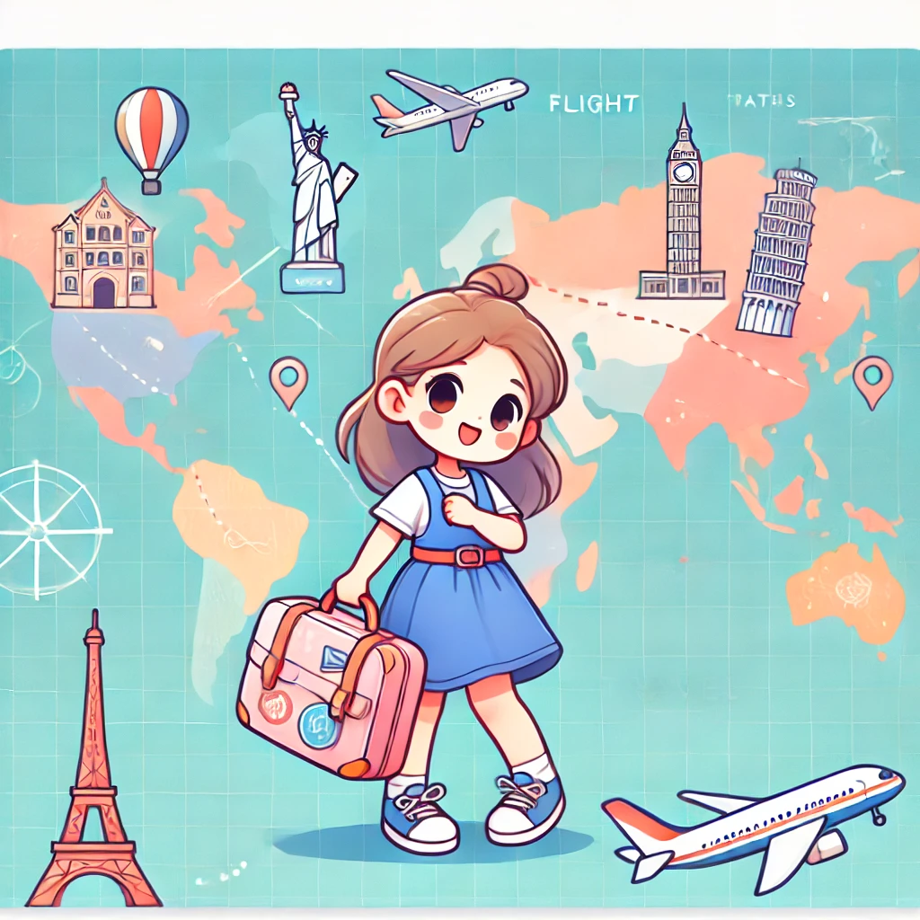
Thank you

